Slide 1
IIS HL7 Interface Testing Process
Open Immunization Software Project

Slide 2
Background
IIS Interoperability Status Check Project for 2013
Majority of IIS included in project
Showed all supported the CDC Implementation Guide
However, majority had additional local requirements
IISSB convened HL7 Interface Training for IIS implementers
The results of these projects point to the need for a standardized testing process to verify that an IIS is fully compatible with the CDC Implementation Guide

Slide 3
Open Immunization Software Project
The Open Immunization Software (OIS) project is a collaborative group of representatives from several IIS projects and one federal agency to coordinate the development of IIS specific software.
The Data Quality Assurance (DQA) application is used to accept immunization HL7 messages and verify that the data in the message meets minimum requirements.
The DQA Tester is a separate application tasked with testing and verifying that the DQA meets requirements.

Slide 4
Proposed Solution
Create a standards based test process for the next release of the DQA application:
Must be documented and clear testing process.
Must be based on the CDC Implementation Guide, guidance from CDC via IISSB, and other relevant standards
Must be guided by DQA user community to reflect actual practice
Must be open source so it can be used by any community member
Must test for compatibility with the NIST certification that EHR vendors a required to conform to

Slide 5
Testing Areas
Core Tests:
Basic: Accept update from EHR
Intermediate: Recognize valid codes
Advanced: Identify quality issues
Exceptional: Allow for minor differences
Additional Tests:
Performance: Reply quickly
Conformance: Respond correctly to requests

Slide 6
Testing Levels
Level 1
The IIS must support because HL7 or CDC standards require it.
Level 2
The IIS should support because HL7 or CDC standards expect it.
Level 3
The IIS may support because HL7 or CDC standards intend it.

Slide 7
Standards Being Used
CDC Implementation Guide, release 1.4
HL7 v2.5.1 Standard
Core fields for IIS in 2007
Core fields for IIS for 2014-2017
MIROW 2008: Data Quality Assurance in IIS: Incoming Data
Input from DQA work groups

Slide 8
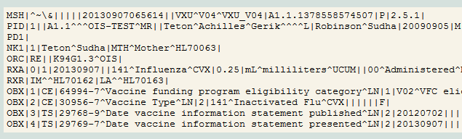
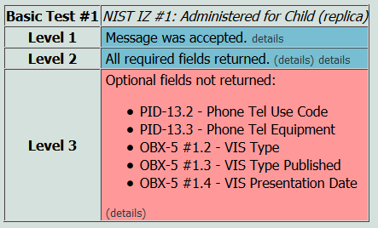

Basic Testing Example
Request
Report
Response

Slide 9

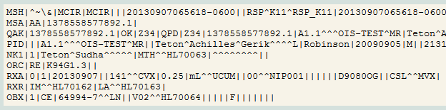
Basic Testing Example
Request
Report
Response
Original Request

Slide 10
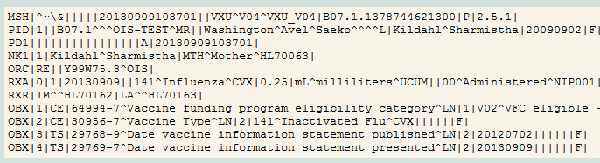

Intermediate Testing Example
Request where Registry Status is Active
Response

Slide 11
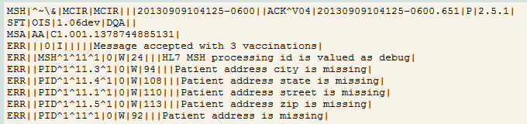
Advanced Testing Example
Request where Patient address is missing
Response

Slide 12
Exceptional Testing
Messages with minor differences allowed by the standard
Observations not typically sent to IIS
Segments not defined in standard
Non IIS data fields with invalid or unrecognized content in them
Observation at the patient level (coming in HL7 2.8)
Example messages from certified EHR products
Currently have some example Indian Health Service messages
Looking to add more in the next year

Slide 13
Performance Testing
Currently expecting:
Response time to VXU’s < 3 seconds
Response time to QBP’s < 5 seconds
These settings may change later
Not a critical part of testing, however the information is available so it’s included in the report

Slide 14
Conformance Testing
Verifies all responses from IIS conform to the CDC Implementation Guide and the HL7 v2.5.1 standard
While the response is read in earlier steps in the test, these previous steps did not test to ensure the messages conformed exactly

Slide 15

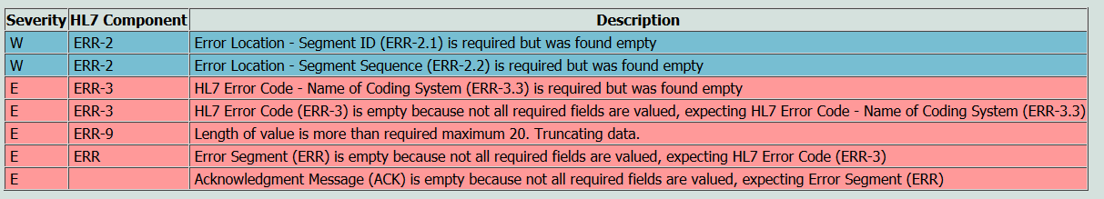
Conformance Example
Request
Analysis

Slide 16
Testing Process Availability
Testing system will be available for use in mid-October 2013
Application is written in Java and requires Java Web Sever such as Tomcat to run
More details available here: http://www.openimmunizationsoftware.net/dataQuality/dataQuality.html

